Slide 1
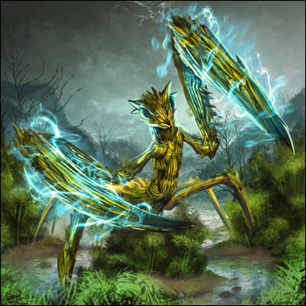
Insect Arena
Electric Shepherds Presents:
Erick House, Gary Mixson, Brandan Haertel, Aaron Whiting

Slide 2
World & Narrative
Who:Dueling Mad Scientists
What:Mutant Insects
Where:Inside a laboratory
Why:FOR SCIENCE!

Slide 3
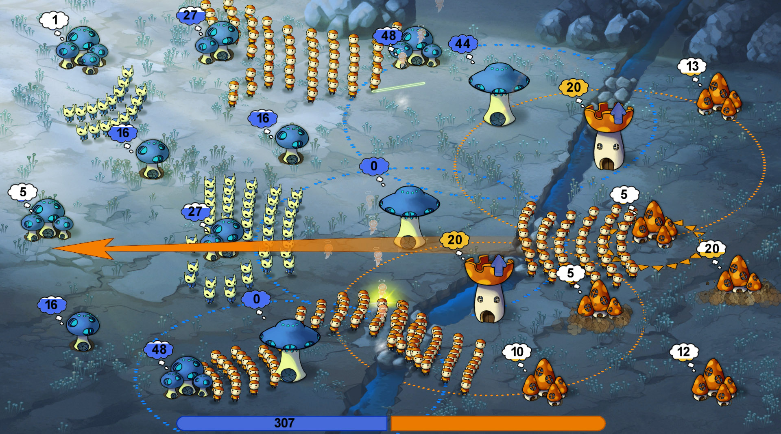
Similar to...

Slide 4
Gameplay Innovations
Insect Arena Innovations
Multiplayer Gameplay
Units fighting in lanes between structures
Mad scientist have powers that can be used to upgrade, and heal friendly units as well as destroy enemy units.

Slide 5
Game Play:Win\Loss
Win\loss conditions
Annihilation: All structures are under the players control.
King of the Hill: Player controls a structure for a certain duration.
Territories: Players fight over control of 3 structures that earn players points when they control them. First player to a 100 points wins.

Slide 6
Game Play:Structure Types
Hive: Generates units
Tower: Shoots at nearby units
Evolution Chamber: Upgrades units

Slide 7
Gameplay:Upgrades
Upgradeable Units
Health
Damage
Speed
Scientist Powers
Magnifying glass
Health increase
Speed boost

Slide 8
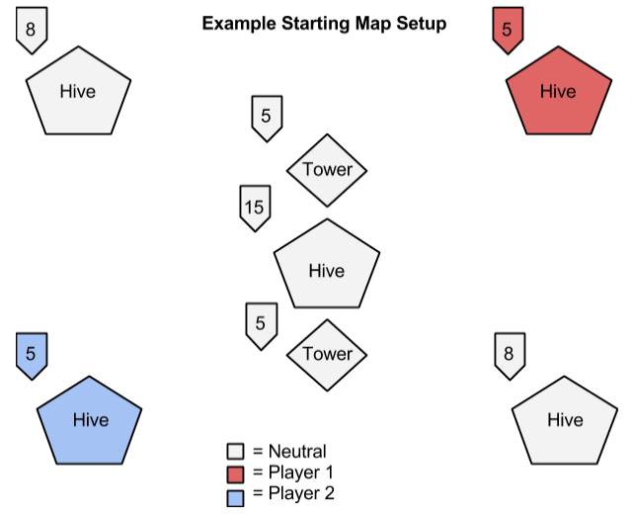

Slide 9
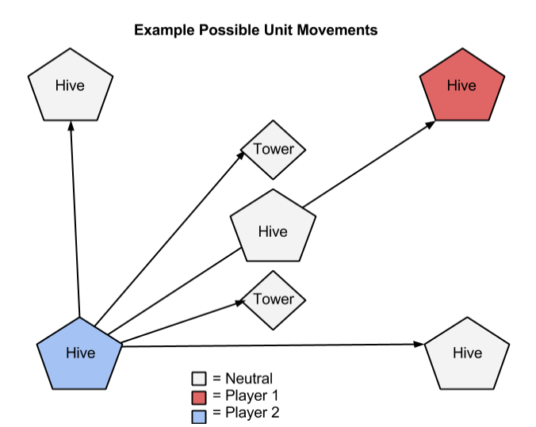

Slide 10
Technical Challenges
Networking
Authoritative/Non Server
Synchronization vs RPC’s
AI
Pathfinding
Potential Fields
Performance

Slide 11
Prototype Test Candidates
Network comm between server & clients
Units navigating between nodes
Towers attacking passing units
Unit upgrade nodes
Max simultaneous units on screen

Slide 12


Look & Feel:Art Style
Good News Everyone!
Futurama styles art
Rounded shapes
Flat surfaces
Contrasting colors
Top down view
Ant Prototype to the right
Adobe illustrator for sprites
“Spine” for building .JSON animations

Slide 13
Look & Feel:Audio & Sounds
Assets
Background, Menu, Win, Kill, Fight, Spawn...
Inspiration
Futuristic Laboratory: Futurama Portal
Source
Sound Engineer With a Professional Grade Studio

Slide 14
Thank you!!
Question?

